Slide 1


Capstone Project
Midterm Presentation
A.Y. 2026-2027
Project Title: AI Security Copilot for Software Vulnerability Detection
Presented by :
Manav Gangar Krisha Chawan Jude Dsouza Neel Vora
70322100089 70322100171 70322100197 70322100049
C109 C082 C116 C108
Under the guidance of : Prof. Sofia Francis
Computer Engineering Department, MPSTME, Mumbai Campus
1

Slide 2
INTRODUCTION
Background
  Software vulnerabilities can introduce significant security risks to modern applications.
  Identifying vulnerabilities in source code requires effective automated code analysis.
  Machine learning and Large Language Models (LLMs) provide new opportunities for understanding and analyzing source code.
  However , vulnerability detection alone does not address the complete remediation process.
Aim
To develop an intelligent vulnerability detection and remediation system using Large Language Models that improves software security and developer productivity.

Slide 3
PROBLEM STATEMENT
Existing Problems
  Manual vulnerability analysis is time-consuming
  Existing systems mainly focus on detection only
  Most models cannot explain vulnerabilities clearly
  Few systems validate generated patches before deployment
  Limited integration of cybersecurity knowledge (CWE, OWASP, CVE)
Problem Statement
Design an AI-powered framework that combines static analysis, retrieval-augmented generation (RAG), and Large Language Models to automatically detect, explain, repair, and validate software vulnerabilities.

Slide 4









SYSTEM ARCHITECTURE
DEVELOPER
ENVIRONMENT
AI SECURITY COPILOT BACKEND PIPELINE
2
SAST Scan
1
Semgrep + Bandit
correlated finding
4
5
6
verified patch
Developer
3
RAG Explain
Patch + Verify
Dashboard
Paste Code on UI
FAISS + BGE-small-en-v1.5
Git apply →
re-scan
React
findings UI
Vulnerability Classifier
CodeBERT
MITRE CWE v4.20
(CWE knowledge base \ reference corpus)
verified / unresolved status → PR comment

Slide 5
Static Application Security Testing (SAST) Tools
Purpose: Detect potential security vulnerabilities by analyzing source code without executing the application.
Workflow
Semgrep: Uses configurable rules and pattern matching to identify insecure coding practices and vulnerability patterns.
Bandit: Analyzes Python code using its Abstract Syntax Tree (AST) to detect common security issues.
Finding Detection: Reports vulnerability descriptions, affected code locations, line numbers, and severity information where available.
Result Aggregation: Combines findings from both scanners to improve detection coverage.

Slide 6
Retrieval Augmented Generation (RAG)
Purpose: To provide the AI assistant with relevant cybersecurity knowledge so it can generate context-aware vulnerability explanations and remediation recommendations.
Workflow
Knowledge Base: CWE Top 25 and OWASP Top 10.
Chunking & Embeddings: Documents are split into chunks and converted into vectors using BGE embeddings.
Vector Retrieval: Relevant security information is retrieved based on semantic similarity.
Context Augmentation: Retrieved knowledge is combined with code snippets and vulnerability findings.
Response Generation: The LLM generates contextual vulnerability explanations and remediation suggestions.

Slide 7
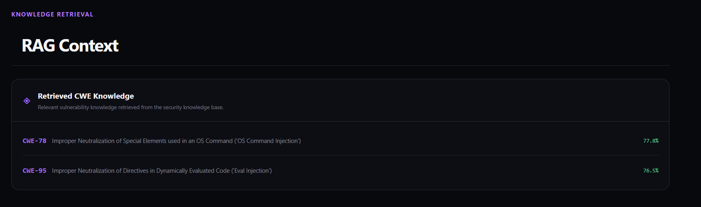
RAG in Practice

Slide 8
LLM - Explanation and Remediation Assistant
Purpose: Converts vulnerability findings into understandable explanations and actionable remediation recommendations.
Workflow
Context Integration: Uses scanner findings, CodeBERT predictions, and retrieved CWE/OWASP knowledge.
Vulnerability Explanation: Describes the security issue, its potential impact, and the underlying cause.
Code Remediation: Suggests secure code alternatives and explains why they reduce risk.
Context-Aware Generation: Generates recommendations based on the detected issue and available security references.

Slide 9
Finding Aggregation and Patch Verification
Purpose: Consolidates detection results and evaluates whether proposed code changes address identified vulnerabilities.
Workflow
Result Normalization: Converts Semgrep, Bandit, and CodeBERT outputs into a consistent format.
Finding Correlation: Groups overlapping findings while preserving source details, code locations, and detection evidence.
Patch Verification: Re-runs relevant security scans on modified code to check whether the original findings persist.
Verification Reporting: Presents remaining findings and verification status.

Slide 10
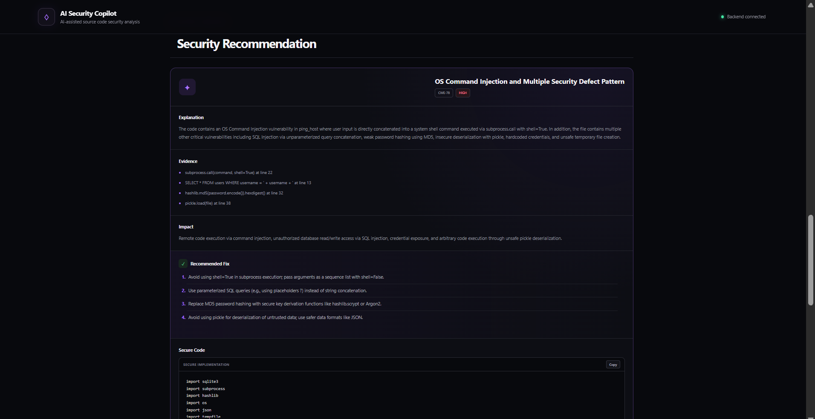
LLM and Patch Verification in Practice

Slide 11
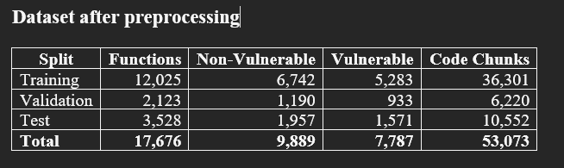
Pre-Processing of Dataset
  Cleaned the dataset by removing missing and duplicate source-code samples.
  Prevented data leakage through source-code normalization and overlap checks across splits.
  Split the data into training, validation, and test sets while preserving class distribution.
  Generated code chunks using 512-token sliding windows with a 128-token stride for Code

Slide 12
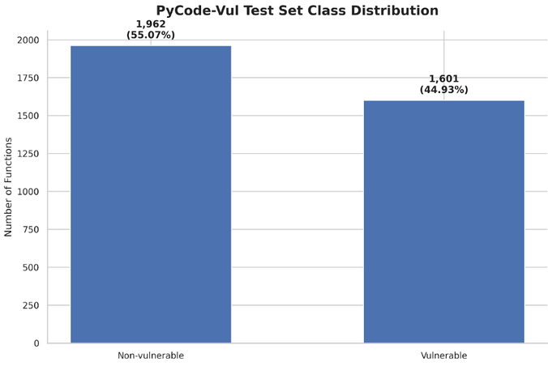
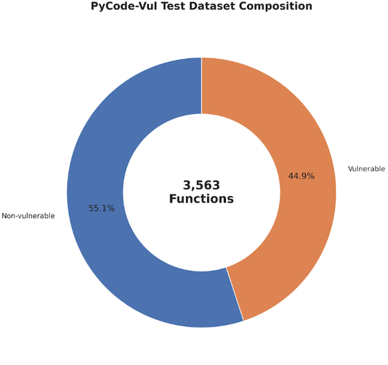
Dataset Class Distribution

Slide 13
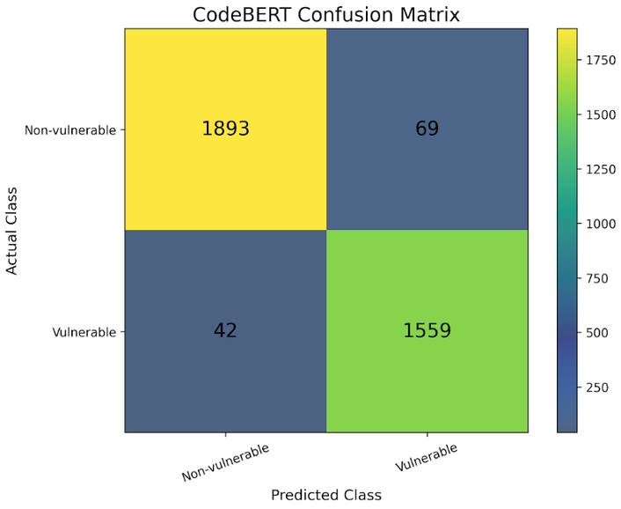
Model Confusion Matrix
Confusion Matrix (Positive = Vulnerable)
TP = 1559 | TN = 1893 | FP = 69 | FN = 42

Slide 14
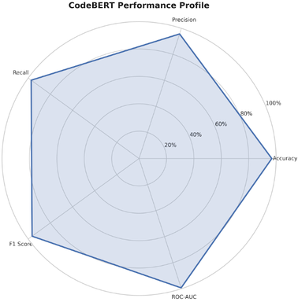
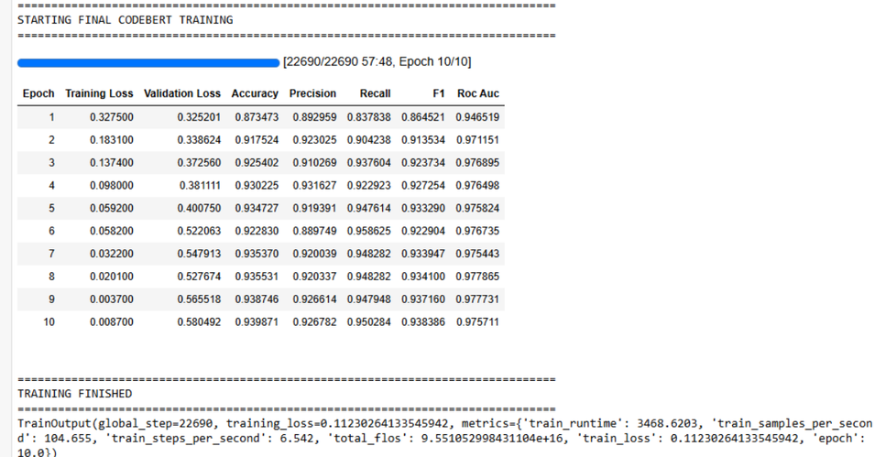
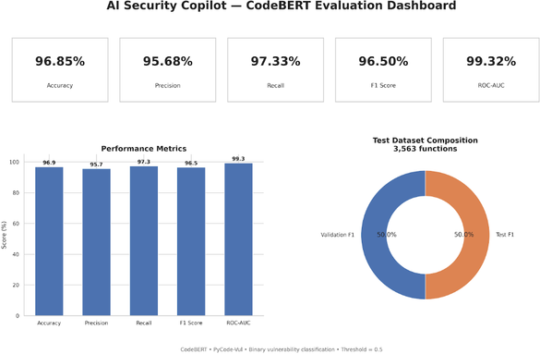
Model Training and Metrics

Slide 15
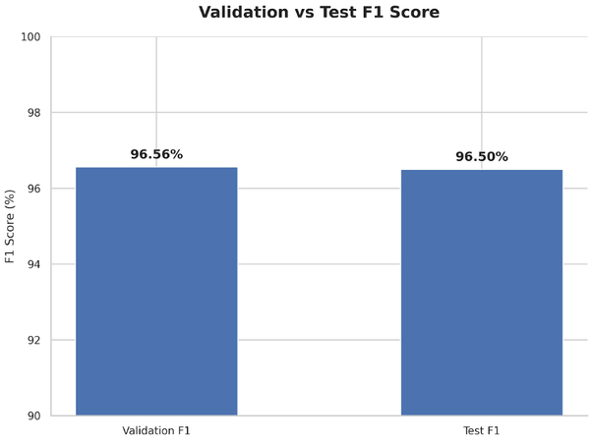
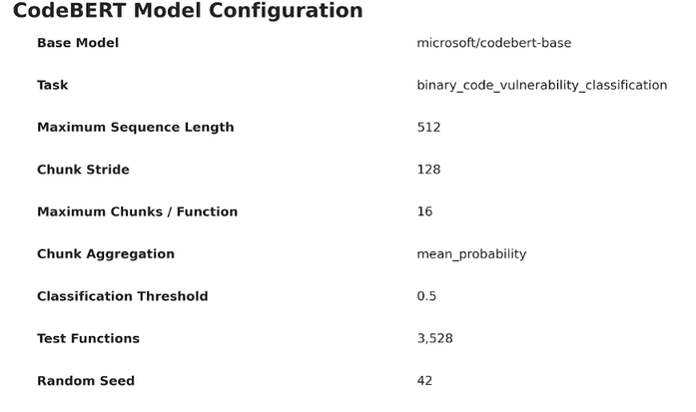
Model Training Score

Slide 16
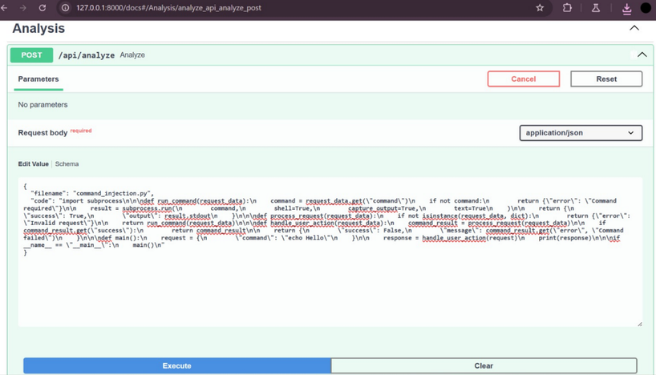
Output

Slide 17
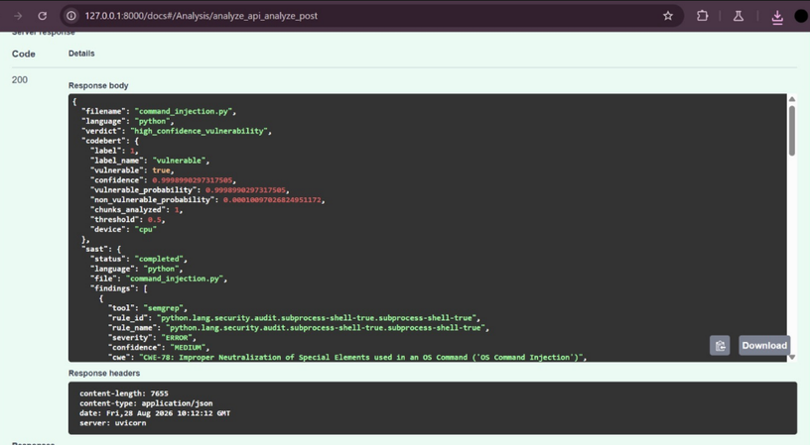
Output

Slide 18
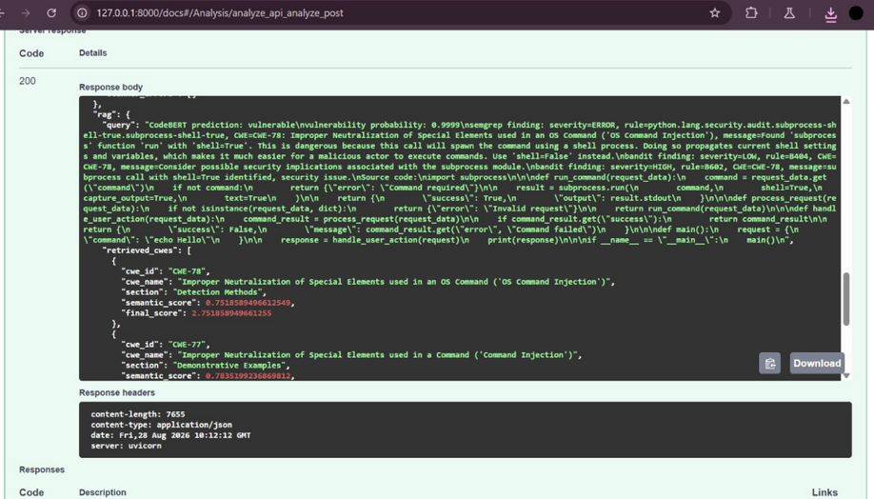
Output

Slide 19
Remaining Tasks
User Interface: The UI development and integration with the completed model pipeline are yet to be completed.
Model Re-evaluation: Re-evaluation of the entire model to validate its performance and results is remaining.

Slide 20
CONCLUSION
  The proposed AI Security Copilot addresses key limitations of traditional SAST tools by combining AI-powered analysis, RAG-based security knowledge retrieval, and automated patch verification.
  The system enables developers to identify, understand, remediate, and validate software vulnerabilities within a single intelligent workflow.
  With its modular architecture and use of industry-standard technologies, the project offers a practical, scalable, and innovative solution for enhancing secure software development.

